Slide 1
Whose idea was this?!
Making Collaboration Work
Notes:
Introductions
Jackie:
Have you ever started to bake something and half way through realized that you’re in way over your head and it’s probably going to be a huge disaster?
And then somehow everything comes together and you manage to pull it off?
Suddenly you have this really cool looking and delicious tart and you think – good thing I trusted myself to start this and then good thing the baking powder I pulled from WAY back in the cupboard wasn’t expired and now, isn’t it beautiful?
Since joining the RESOLVE Campaign, I have had many moments where I wonder “Whose idea was this?!”
Thankfully we have someone like Sheryl Barlage leading our team and reminding us that we can do it – we may not have ever done it before – but it will all be worth it.

Slide 2
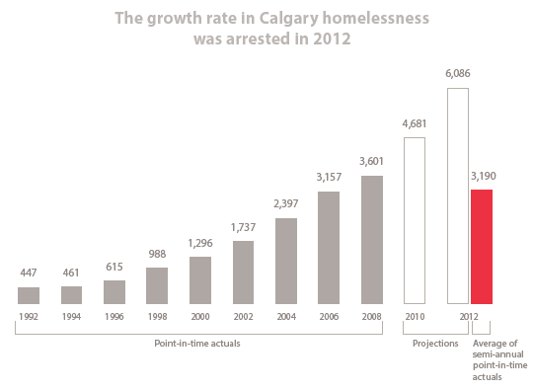
The Situation
1994-96 Calgary had the fastest growing homeless population in Canada…
Something had to be done!
Notes:
Sheryl:
Background

Slide 3
Collective Vision
Audacious Goal
Calgary’s Campaign Environment
17 Interviews
Feasibility Study
Notes:
Sheryl:

Slide 4
90% supportive but not a philanthropic priority
Time for private sector to step up
$300-$150 Million too high
Collaboration is critical
Cost Savings
Anchored in
10 Year Plan
The Results
Notes:
Sheryl:

Slide 5
Building the Foundation – Finding the Path
Readiness
Tracking and reporting
Infrastructure
Leadership
Undesignated allocation
Communication
Staffing/administration
Database management
Donor recognition – strategy & implementation
MOU
Accountability & stewardship
Document infrastructure
Confidentiality/FOIP
Case
Organizational structure
Name/theme
Accounting/legal/ investment firms
Events and donor event planning
Notes:
Sheryl:

Slide 6
RESOLVE
Shared Goals
First in Canada
Unique
Notes:
Sheryl:

Slide 7
“Collabetition”
Notes:
Sheryl:

Slide 8
Remember the Collective Impact
Notes:
Sheryl:

Slide 9
Leadership Changes
Economic Downturns
Unanticipated Events
Timing
Philanthropic Environment
Navigating the Path
Notes:
Sheryl:

Slide 10
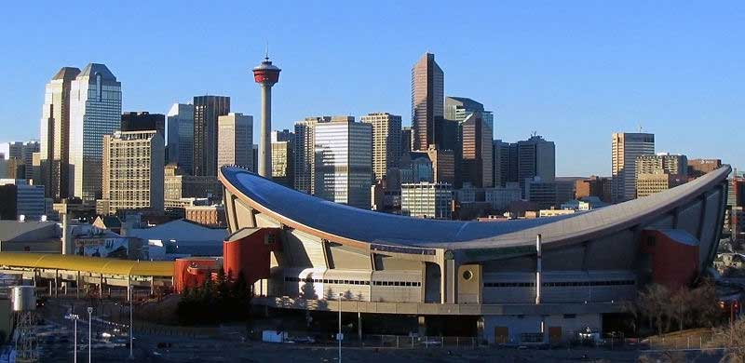
Collaboration | Transformation | Legacy
Goals of RESOLVE
Notes:
Jackie:
Most of you in the room are the experts on how to best serve our homeless sector. We don’t have that kind of expertise but we do know about fundraising and building relationships with philanthropists that can transform an organization.
Back to the baking analogy: this is a lot of work and requires a lot of resources to make it successful – which is why we only want to do it once.
We want this to be a permanent solution. That means that all of our social service agencies will be able to sustain the level of care in the City, thanks to the great relationships they are building with individuals, families, foundations and corporations who are committing to make this happen.
That brings us to the most important part of the Campaign: Transformational Legacy through Collaboration.

Slide 11
Identification
Qualification
Cultivation
Solicitation
Typical Donor Cycle
Stewardship
Notes:
In a typical campaign, donors go through what we call a cycle.
They learn about the cause, they warm up to the cause, they give to the cause and then through strategic stewardship, they hopefully give again.
Donor story of growing support through effective stewardship. [ie: Denis Moher]

Slide 12
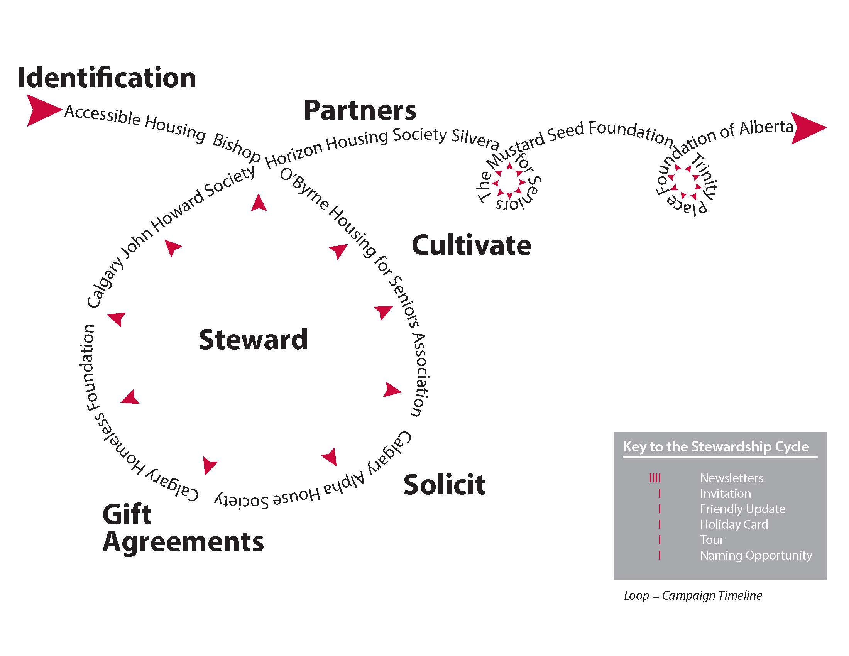
RESOLVE Donor Cycle
Collaboration | Transformation | Legacy
Notes:
As a collaborative Campaign, the RESOLVE donor cycle has all sorts of additional levels of complexity.
A donor learns about the Campaign and they may choose to support one of the Partners or they may choose to make an undesignated gift to support all of the projects in the Campaign.
Some of the agencies have never done fundraising before and so RESOLVE works closely with the Partner through all stages of working with a donor. This helps donors become connected with a Partner and teaches Partners about relationship building through a fundraising lens.
You will see the second loops and those are designed to show that once the RESOLVE Campaign sunsets, donors will continue to work with agencies and can continue to make a difference in the homeless serving sector.
This is one of the ways that we are working with donors and Partners to build a legacy of continued support after RESOLVE has dissolved.

Slide 13
Fundraising Audit
Stewardship Plan
Sharing donors
Donor and Campaign Impact
Intellectual Property
Ongoing collaboration
Capacity Building
Notes:
That is how RESOLVE came to have two goals. The first is to raise the money to build homes now. The second is to build capacity for the Partners to maintain this level of service after the Campaign.
Building capacity for these agencies means giving them the tools necessary for them to continue working with these donors after the Campaign sunsets.

Slide 14
Ideal goal and number of Partners
Partners prepared to compromise
Willingness to work for greater good
Consideration of individual agency goals
Celebrate successes together and share the challenges
Respect and accommodate the differences
Collaboration
Notes:
Sheryl:

Slide 15
Cooperating Beyond the Campaign
Notes:
This also fosters other great partnerships
Letter to gov’t signed by all partners
BOB accessible units
Silvera/Accessible

Slide 16
Recipe for Success
Notes:
This also fosters other great partnerships
Letter to gov’t signed by all partners
BOB accessible units
Silvera/Accessible

Slide 17
Government of Alberta investment
4 Calgary visionary homeless-serving affordable housing agencies
Owning debt-free rental housing to sustain low rents
Collective Vision: To RESOLVE housing crisis
Successful Campaign
Ingredients

Slide 18
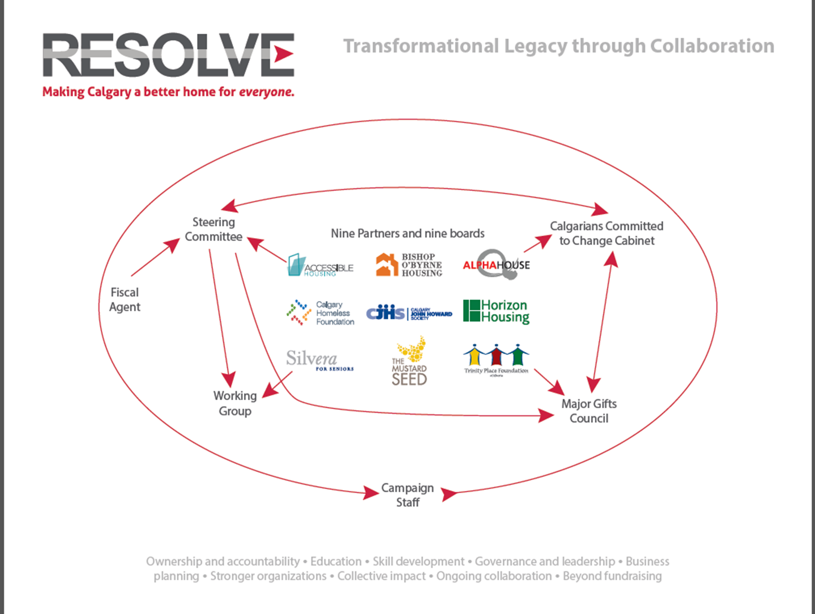
Baking Instructions

Slide 19
Notes:
Final Product – story of the Valencias

