Slide 1
Aboriginal Homelessness: A ‘Belief’ in Housing 1st’
An Aboriginal Outreach and Cultural Re-Connection Program as well as Housing, 1st practitioners approach to ending Aboriginal Homelessness rooted in a belief of an old way of life and how that belief is shared with whom we work with and to give back a lost identity for sustainability in housing and prevention of Homelessness.
Notes:
As Aboriginal people, it’s been taught to me, we’ve always believed in a connectedness to our Mother Earth, a kinship with all creation and beyond; to the spiritual realm of life and the great mystery.
We believe this, wholeheartedly, I believe the Great Mystery is at work right now, as I move as I talk as I think as I speak and try to convey this belief to you. I believe I am at work with all those things that my ancestors believed in, prayed for me to have them today and as I will do so for those yet to come and its only through this belief that we are able to show those with whom we work with the all-encompassing acceptance of this belief and how we see it directly correlates with housing 1st to make it work for our people entrenched in homelessness.
At the Aboriginal Friendship of Calgary, we have an Aboriginal Outreach and Cultural Re-Connection Program and we are Housing 1st Practitioners within our program with an acceptance of harm reduction. Inside this program we focus on a belief from our old ways of life as 1st nations people with practices we’ve had since our beginning's and we use these practices to give back the pride, the lost identity for sustainability and prevention of homelessness for our homeless people.

Slide 2
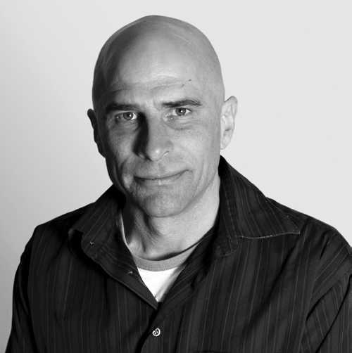
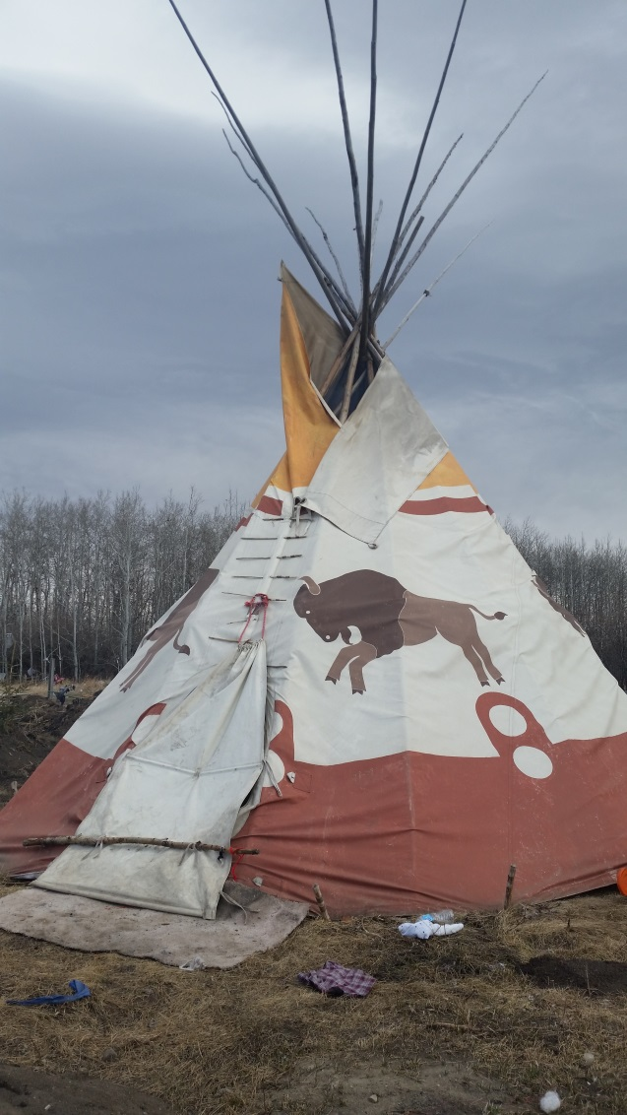
Aboriginal Friendship Centre of Calgary: Cultural Re-Connection Program
Notes:
My name is Sydney and I’m 1 of 7 people directly involved with this program. At the AFCC, I am 1 of 2 Outreach and Cultural Re-Connection Workers there. I have a partner I run with out there, his name is Brad Fisher and he is the originator of our program, Brad is also a 2009 -2010 Art Smith Award winning Frontline worker. His 1st year on the scene and together we do our best as common men to aid homeless aboriginal people through our belief we share.
What is this belief? What is this program?
Firstly, let me tell you where we both found this belief - prison.
Prison was my 1st encounter with this way of life because I am a fall out of the residential school system, my grandparents were taken and then the atrocities occurred. They then were sent home and together made a family, a family full with dysfunction, abuse in all forms, alcoholism and no practice of the way of life as 1st nations people like so many others. So, my mother left the reserve as soon as she could with my brother and sister and never looked back, hence I was never raised in the traditional way and had no connection to them until I started my time in the Correctional system.
It was in prison where I started to follow the practices of this belief, wholeheartedly and committed (my brother also). Even though I was restricted and limited to that environment, I would do what was taught to me as required daily because sometimes in prison, things got out of your control, for instance, your very own front door… And when you are allowed out of it.
By the time I had made it to the Federal system, I had been around these ways now from being in and out of jails; other beliefs of it taught by other men I had met because at this point a man was showing me this alter where my belief was found, although it always did speak to me in every variation but this variation, this alter was different for me. It taught compassion in its rarest form, it showed me acceptance of all no matter what, again and again because you had to give your all to be there for the people. My brother and I we’ve suffered, we’ve sacrificed but that’s a story for another time!

Slide 3
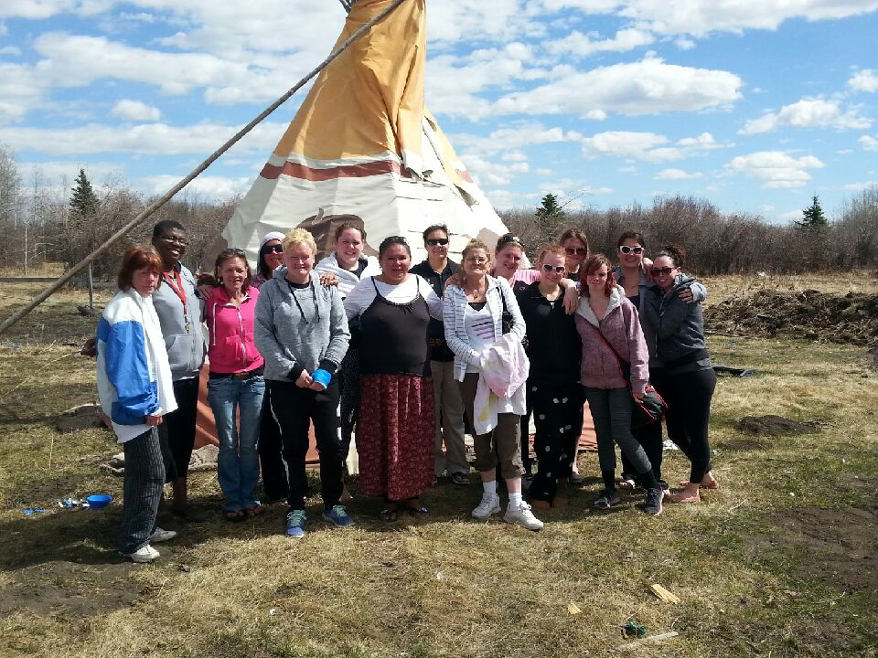
Aboriginal Friendship Centre of Calgary: Cultural Re-Connection Program
Notes:
We identify as Aboriginal, 1st nations, My brother and I. A Cree and a Mohawk
I am registered on my mothers’ reserve as an Indian under the Indian act, statues card and all. More importantly, we believe in a way of life that also recognizes that having a home as a fundamental principal/right of all the members of society/tribe/ clan no matter their place like Housing 1st in the here and now; Furthermore, it was up to the whole tribe(s), cause their wasn’t just one. When we all gathered back in the day, we all had to come together for our people when they were outside with nothing to give them a home. Food, warmth and a knowing they belonged to a community, to me Collective Impact since our beginning's.
So we wanted to use this belief in our program to give it back to the people so they could know they can live apart from homelessness and be an Aboriginal person who, if they so choose, could practice their cultural practices freely and proudly.
This is the tipi and a group of women from a treatment facility we work at our gathering place.

Slide 4
Aboriginal Friendship Centre of Calgary: Cultural Re-Connection Program
Goal 1:
Assist homeless Aboriginal people with a continuous improvement of lifestyle adjustments to help them find and maintain housing per the housing 1st philosophy using culturally appropriate supports
Goal 2:
Offer culturally based holistic interventions to Homeless Aboriginal people in Calgary
Notes:
Fast-forward 15years for me and 30 for my bro, here we are, Housing 1st. And how we apply this belief to working with those we serve and how we make it work in Housing 1st, so we can effectively and efficiently put a stop to this issue we created and now have to solve together.
So, inside our program we came up with, with help, what we can see here:
Goal 1: read goal
Goal 2:read goal
Our belief in the way our ancestors lived has been the key to us being able to share this belief with the people we have been working with to achieve these goals.
And this belief is a prayer, plain and simple, said by a common woman or man, anyone of you for instance or more importantly those we serve, it’s rooted in the home and keeping Good Health, Happiness, Help and Understanding in the home, It’s not religious, it’s spiritual. And these roots grow into every aspect of your being, the physical, the mental, and the spiritual. The only root it won’t seem to sprout though is the money tree…
It’s a prayer for a better tomorrow said by my ancestors, for over 19 generations, for future generations to come cause they knew of the hard times our people would face, it’s a prayer said by me for a better tomorrow for my children and future generations, it’s a prayer I try and share so it will continue on into the future. Consensuses is, (in Indian country), we always want it here to be able to help us live and thrive and for future generations. It’s a prayer we’ve spent years developing and will continue to do so as we grow.
It’s a prayer we’ve learned to share with those we work with and serve by simply showing the complete acceptance of this belief no matter their place in society and having a right to a home first and foremost,(housing 1st), and furthermore no matter the level of complexities/addictions or needs, (Harm Reduction), and as many times as it takes.
To us we had aligned our belief with the goals we had made to make the program match or peoples complexities with solutions that were time tested to be true for Aboriginal people by Aboriginal people.

Slide 5
Aboriginal Friendship Centre of Calgary: Cultural Re-Connection Program
Objectives:
1: Provide outreach services to Aboriginal people in shelters and on the street by: Intakes, referrals, advocate and provide assistance to homeless people to help them identify and obtain long term housing according to Housing 1st
2: Deliver and promote cultural activities for Aboriginal homeless and recently housed people
3: Collaborate with homeless and community based agencies to offer Aboriginal Programming connections
4: Expand program complement to build capacity internally
Notes:
To achieve our goals, next we came up with the objectives we needed to meet for our program and through our belief, consistency and partnerships, we love our partners and thank you, thank you to them and to the people. We have been able to meet these objectives to achieve the goals to see success in the people through the belief in the program inside of Housing 1st as practitioners.
I spoke to the love we have for our partners and collaborators and it was through there willingness to work with us and allowing us into there shelters, detoxes, offices, we were able to offer these Aboriginal way of life programming connections.
Objective 3(read aloud) made it possible to meet objectives 1,2 and 4. and the hard work of my partner in the pilot year of 09’.
With this ground work now laid we were in all our partners spaces providing outreach services to the Aboriginal clients through the intake and referral process, we were advocating and identifying housing to have folks housed firstly and mostly cause that was the need: that met objective 1 for us.(read objective aloud)
Objective 2 was also well on its way with the acceptance of 3, the consistent delivery of cultural activities for Aboriginal homeless and/or recently housed. This says we are an Aboriginal Centre delivering Aboriginal learnings to Aboriginal people either homeless or recently housed and we were and still are with this program, objective met.
Objective 4 was met with a fine complement to build capacity at the Centre, with the finely quilted relationship we had with the rapid re-housing program we were working with in housing our people at the time. Together we came up with a proposal for a housing program to be operated out of the AFCC in partnership with, we were granted this housing 1st program, it has had its struggles but remains strong and solely operated by the AFCC, it is called the Aboriginal Housing Initiative or AHI, and our capacity has doubled at the Centre and the Cultural Re-Connection program has flourished and grown to expand our work into the Justice, Health, and Education systems in and around Calgary.

Slide 6
Aboriginal Friendship Centre of Calgary: Cultural Re-Connection Program
The AFCC had been delivering the Outreach and Cultural Re-Connection Program since 2009
The program focuses on continuous improvement of lifestyle adjustments inclusive of cultural integration, knowledge transfer, community support services, advocacy, all combined with referrals internally and/or externally for housing solutions for Aboriginal clients
Notes:
(read slide)
July 2009, the AFCC is a yellow old retro-fitted into offices house and the upstart of the program is going. First sweat November ‘09
Today we’ve grown and moved main office location and operate 2 satellite offices for Case management for our housed folks and for greater access to Outreach and Cultural Re-Connection.
With our program we have always focused on giving the people a house to make a home no matter the complexities and with this belief it is the hopes the improvements will be made in lifestyle, client driven, with cultural beliefs and other supports needed intact.

Slide 7
Aboriginal Friendship Centre of Calgary: Cultural Re-Connection Program
Services for Aboriginal people are Culturally appropriate at the AFCC and the Outreach and Cultural Re-Connection Program continues to lead the way in provision of best practice cultural and holistic intervention assistance for Homeless Aboriginal people in the City of Calgary.
The program offers daily outreach and/or Cultural re-connection services
Notes:
(Read slide aloud)
We believe this at the AFCC and if you haven't figured by now, we’re not to shabby at belief
We serve the urban Aboriginal population to the best we can and we believe we lead the way in serving the Homeless Aboriginal population in cultural practices cause we will work with these women and men even though addictions are prevalent and upfront, we will work with them in cultural practice and holistic interventions daily.

Slide 8
Aboriginal Friendship Centre of Calgary: Cultural Re-Connection Program
Clients
Clients
Re-Connection
Cultural
Notes:
Here we see a visual, just to help form a minds eye view, of how we saw the non-Aboriginal homeless serving agencies trying to serve Homeless Aboriginal people.
In the first part of this visual we see the people we are trying to serve in the middle and all the surrounding circles are agencies who all play a part in wrap around tailored services to provide safety, dignity and home for the people. It wasn’t for lack or want to not help homeless aboriginal people we found cause like I said earlier, we were welcomed with open arms to aid in the service of our people.
We had all these agencies wanting to help and the beginning's of the 10year plan were six years into by Calgary’s count.
Housing 1st, that’s the arrows, that’s what they represent. A house firstly and with no pre-cursors, no expectations, just somewhere for the person to not be homeless to hopefully work on the issues that brought them to homelessness.
And on the other side we see the complete circle of everybody working together to solve the issues we need to work on to be complete in our lives as Aboriginal peoples and keep our homes, in a perfect world right, we all know this could take time and time again for our people to be able to live in a house let alone make it a home.
Underneath this process from clients being circled by the circles which represent agencies through the housing arrows, CAA now a days, to the complete circle and wrap around, we see Cultural Re-Connection and that’s us at the AFCC for the clients and partners we work with. We try and serve as that solid foundation needed to build upon, no matter how many times the big bad wolf blows your house down and we are there for the journey for those who are achieving sustainability of their home and for those trying to maintain that housing. Much like Calgary's system of care framework flow chart where you see supportive services and outreach throughout as a footing, we do the same with our Cultural Engagement and Re-Connection.

Slide 9
Aboriginal Friendship Centre of Calgary: Cultural Re-Connection Program
Understanding
Happiness
Good health
Help
Notes:
Here is another visual aid to help illustrate the belief we try and grow within the people to achieve all those good things on the red road or whatever road you want to take to make your journey.
Good health, happiness, help and understanding, the basics of what I was taught when I started with this alter, this belief.
The Grandfather equation is what we like to call it cause with these things in your life in working with the 7sacred rights anything is possible.
We start to work with our Good Health in our belief, above all else, and the women and men start to work with this also even if its only for small windows of time, say time enough for them to make a Friday and we’ll get to Fridays shortly here, so our good health and chasing it is very important cause when we feel healthy, we can feel happiness not a substance or beverage or non-beverage induced happiness but a genuine feeling cause we’re feeling good health or on our way. Detoxing.
Lets also remember that there's a continuum of services through this journey and we’re trying to build this piece, cultural re-connection, inside the folks we work with. Good health is achieved, a person has made it through the beginning's of the battle for their life, they’ve detoxed and we’ve seen this.
Next comes Happiness and this we can share and have ourselves, have and share with others cause we know the struggle it took to get to only here, detoxing, sobering up, it hurts and that’s only the beginning.
Good health and happiness, we’re housed we’re living healthy. We’re happy. On to help.
We’ve been helped and we’re thankful for that help to get here, we can ask for help when we need it, we can give help to others. We want to help and help ourselves to keep this happiness, this good health that we’ve work to get.
Than we get to understanding, here we can look back and reflect on the journey we’re on. What we’ve done to get here and how we can stay here. Understanding as Aboriginal people we can live our way of life to be a whole complete person with a home, with a name, with an identity to hold in high esteem and prestige as we once did as a nation bursting with Good health, Happiness, Help and understanding.
We all know this journey doesn’t happen overnight and the road is long as well as rough, travelled time and time again for some folks but with consistent practice of our cultural ways reinforced with supportive services, a person, a family can make it. 15 years for me, 30 for my partner, a lifetime.

Slide 10
Aboriginal Friendship Centre of Calgary: Cultural Re-Connection Program
Notes:
AFCC frontline workers interact with hundreds of cultural/traditional/spiritual dispossessed and socio-economically deprived clients yearly, as our HMIS data shows, with a core intention to continue to address and close the service gaps Aboriginal people who are homeless in Calgary currently face.
This is 18 months of data of people accessing our program for not only Cultural re-connection but for basic outreach services such as food hampers, referrals internally/externally, bus tickets, comfort items, I.e. socks, mitts, toques, sweet grass.
While many services exist to address the homeless population, Aboriginal people remain disproportionally overrepresented among the homeless population in Calgary, point in time counts tell us so, and present unique challenges to non-indigenous agencies.
AFCC Outreach and Cultural Re-Connection program has developed an internal and external community collaboration system that enhances access to cultural re-connection and cultural practices for sustainability in housing and prevention of homelessness.

Slide 11
Aboriginal Friendship Centre of Calgary: Cultural Re-Connection Program
Notes:
(Friday Sweat HMIS Data and sign up sheets)
This is where we get into the real good stuff! The goodness we have been fortunate enough to share with the people as you can see here pulled from our HMIS data and lodge sign up sheets.
Friday Sweat Lodges!
It’s been taught to me this is the oldest form of prayer we have as Indigenous people of these lands, it’s one of our 7 sacred rights and/or teachings, the Sweat Lodge! Inipi Wakan. A purification ceremony, mind, body, soul.
The lodge has been the corner stone of my people since it was shown to us and also the cornerstone on which we have approached this issue of Aboriginal Homelessness in Calgary since the pilot year of 2009-2010 with the Cultural Re-Connection Program; We’ve been a part of the efforts to end Homelessness in Calgary since the beginning's of the 10year plan but of much more importance; we’ve been able to share this lodge with all of the people we work with and with this lodge we share a belief in whom we are as 1st Nations Peoples/descendants and how this belief has always had collective impact, leadership, innovative and best practices for us as 1st Nations and how the people being housed 1st within Housing 1st with harm reduction apply this belief to their Housing in helping themselves into housing sustainability and prevention of their own homelessness.
(Refer to slide)
Throughout this 18 month span of HMIS data with 306 unique homeless women and men interacted with we have 78 Fridays in that time frame and never on a Friday has there been less then 7 folks but we have missed a Friday or two. 70 sweats, mathematically that works out to 490 folks and we have this data, Aboriginal and non-Aboriginal alike, out to lodge , it happens every Friday and has been since we’ve began the Cultural Re-Connection at the AFCC. Many of these women and men continue to participate time and time again as the numbers tell(306 interacted ‘uniquely’ and 490 out to lodge, repeats), it shows in their everyday lives, not only are they sustaining housing, some of these folks have gone on to Sun Dance and Hanbleceya(Vision Quest); through experiential learnings, a name for a way we have always taught our people, we have been able to share and start to give back an identity to some of those whom have lost it and educate all those partners we work with, in this way of life. And with this lodge we have been able to begin to build the Collective Impact needed by bringing not only my people back to this way of life but also bringing the Homeless Aboriginal serving agencies with whom we partner, who partake by choice of course, in ceremony themselves to witness the beauty, power and lineage of what we believe. To educate them in a way of life for the people they themselves have been trying to assist for years, this beginning's of Collective Impact has allowed for the togetherness of executive directors, housing directors, program managers, funding body representatives and front line workers, like myself, with the people we all serve, through this belief, this lodge, this original way of life for us, we have also begun to build community and social integration by having all walks of life join us on Fridays from the Calgary Community. Everyone accepting of one another and equals all working together
Sweat Lodge Fridays wouldn’t happen if it wasn’t for the partnerships and support of those involved in this movement, you know who you are and we thank you, we humbly thank you.
We have found these men and women in all states of disarray and addiction, on the streets, in the shelters, on the mats and always have approached from Harm Reduction and Housing 1st because like I said earlier “a home for all no matter what” is something we believe in also within this belief and we always offer up a chance to come to the lodge on that coming Friday and a many of the people will do what it takes for them to be there in sobriety for that time and a many will not and that’s ok cause maybe next time they will come or the time after that. Homeless, recently housed or trying to sustain, trying again for the umpteenth time, it doesn’t matter because with this belief you are your own person on your own journey to Good Health, Happiness, Help and Understanding in your life. As my Brother, my partner, Brad Fisher, the man who started this program and continues on today has always said ‘and me as a man I am only here to help, by hauling wood and stones, building a fire to heat the stones, carrying them into lodge and pouring water the rest is between you and them, if you are sincere you will get your help’ as we believe this way of life does.
This Lodge, this way of life has inspired leadership into the people we work with to give them back that pride as 1st Nations peoples and allowed for prolonged sobriety in some folks and they have moved on to a more in-depth practice of this way of life which leads to keeping housing intact with the most innovative and best practices we have as 1st nations people and these practices are our 7 sacred rights, the lodge itself being one of those rights. They have taken it upon themselves to be leaders for others coming from where they have and show them it is possible to be successful in housing within working with this belief and its acceptance of how many times it takes and/or what it takes while you heal on your journey to that Good health, Happiness, Help and Understanding. All aimed at keeping the house that person has made a home out of or is attempting to make a home out of.

Slide 12
Aboriginal Friendship Centre of Calgary: Cultural Re-Connection Program
Notes:
(Monday drum data)
Another best practice we are able to share with the people is the sacred drum and its connection to us and our mother earth, as you can see here the amount of people is substantial also and the connection it brings in its presence to the people to bring them back to who they really are inside. We see the pride swell as we all work together around that drum to make the harmony we want to duplicate in our lives. These women and men who participate make this possible and share in that good health, happiness, help and understanding with one another and it shows.
Again, here we see sustainability, sustainability in the self, created with the drum, for that stability to be able to achieve housing and/or keep their current housing. We do these circles in shelter settings and again, thank you to our partners for allowing us in there spaces to make the beautiful music we get to make with the people through the drum.

Slide 13
Aboriginal Friendship Centre of Calgary: Cultural Re-Connection Program
Sweat Ceremony Feedback Comments:
“It was my first sweat; I found the lodge excellent, the scenery, the view, the fire, all part of an excellent spiritual experience. Thank-you!”
“ Awesome sweat, pray all our prayers are answered, hey, hey all my relations.”
“Pushed to the edge, great sweat.”
“Thank-you for giving me the opportunity to participate. My heart is warm.”
“The sweat was forthright, real and brutally honest and because of that it is a loving and healing experience.”
“I really enjoyed it. It’s been a long time since I’ve been in a sweat; I’d like to go again, thank-you very much.”
“My first sweat ceremony, I needed it. To give and receive support from others gave me a strong sense of community. Thanks for the experience.”
“Thank-you for bringing me home.”
Notes:
Going Forth with the people and in closing of this talk here, It is our intention to bring to light the hard work put forth by the people we work with in chasing their good health, happiness, help and understanding by simply participating as well as the importance of providing the cultural practices, best practices, we have as Aboriginal peoples for our people experiencing homelessness to participate in, in which ever of the 7 cities a program type like this needs to exists.
We can see this importance from the comments here from clients who have and who access the program.
Thank you very much.

