Slide 1
Alberta’s Second Stage Shelters:
Transitioning from Domestic Violence to Stability
Carolyn Goard, Alberta Council of Women’s Shelters
Pat Garrett, Wings of Providence
7 Cities Housing First Conference
May 6-8, 2015
Edmonton , Alberta

Slide 2
What are Second Stage Shelters
Second stage shelters provide safe, longer term (6 months to one year) apartment‐style supportive housing that are part of the spectrum of domestic violence and housing services
Specialized domestic violence services ensure safety

Slide 3
The Second-Stage Shelter Project Overarching Goals
Establish a process for collective outcome measurement in Alberta second-stage shelters
Use data to improve shelter services
Support shelter efforts to secure core funding

Slide 4
Two Phases August 2013-September 2016
Phase I: Completed November 2014 (funded by the Canadian Women’s Foundation) Completed:
Literature review
Logic model development
Data gathering & analysis
Final report https://www.acws.ca/collaborate-document/2479/view
Phase II: Underway December 2014-September 2016
Implementation of goal attainment & other outcome measurement tools
Development of an acuity scale

Slide 5
Phase I Literature Review: Need for Second Stage Supportive Housing
Women now make up around one-quarter of the homeless population (Tutty, et al., 2009).
Domestic violence is one of the main causes of homelessness - 63 % of homeless women have been victims of domestic violence as adults (Brown and Basek, 1997)
Lack of housing options or appropriate housing options for women with domestic violence history

Slide 6
Phase I Literature Review: High Risk
(Paraphrased) Question | Emergency | Second stage
1. Physical violence increased? | 66% | 85%
2. Does he own a gun? | 20% | 16%
6. Does he threaten to kill you? | 45% | 73%
13. Control your daily activities? | 78% | 94%
15. Were you beaten while pregnant? | 37% | 60%
17. Threaten to harm your children? | 18% | 65%
18. Do you believe he is capable of killing you? | 59% | 88%
Cairns K.& Hoffart, I. 2009. Keeping Women Safe: Assessing the Danger A report prepared
for the Alberta Council of Women’s Shelters. https://www.acws.ca/reports

Slide 7
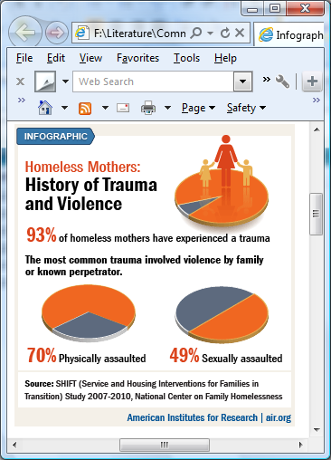
Phase I Literature Review: History of Trauma

Slide 8
Phase I Literature Review: Mothering
Exposure to IPV has a traumatic impact on children, especially the very young who are more vulnerable given the rapid brain development that occurs at this stage of life
Impacts of trauma on brain development in the first five years have a lifelong physical, cognitive, social and emotional impact (Hoffart, 2012)
Mothers’ stress related to parenting is higher for women in second stage shelters compared to those in emergency shelters
Hoffart, I. 2012. ACWS Children’s Project. https://www.acws.ca/reports

Slide 9
Phase I Literature Review: Immigrant & Refugee Women
A third or more of the urban VAW population is immigrant or refugee.
Women face multiple challenges, including poverty, language, acculturation, exploitation, isolation and lack of informal supports, sexism and racism, custody and legal issues
“A single immigrant woman who struggles with English has not been able to locate employment and is not eligible for public assistance. She is able to find housing, but does not have the financial ability to move into her own apartment. Public funding is difficult for single women who are not eligible for assistance, and do not have the skills to obtain employment that will provide enough wages for rent.” Excerpt from 4th Quarter Women’s Shelter Report, Alberta Human Services (2013)

Slide 10
Phase I Literature Review: Violence, Poverty & Housing
“Increasingly it is becoming clear that a lack of affordable and safe housing and poverty have significant impacts on women’s decision… [to leave] an abusive partner. Housing has been identified as a significant concern, one that not uncommonly can force a return to an abusive relationship” (Tutty, 2006).
ACWS exit survey data from 2007-2008 states that 57% of women who stayed in emergency shelter in the past returned to the same relationship, citing the following reasons for return:
lack of affordable housing 42%
lack of money 45%
fear 38%
Access to affordable housing is particularly problematic in rural communities and small towns

Slide 11
Phase I: Second-Stage Logic Model
Inputs
Governance | Resources: Financial, Human, Technical, Volunteer, Community | Program Operation and Administration | Facility Operation
Activities
Measured using services provided and referrals lists in Outcome Tracker and agency documentation to describe community programming
Site Management | Safety Programming | Comprehensive Services to Women and Children | Services to Support Long-Term Housing Stability | Community Programming
Shelter roles/responsibilities | Shelter and individual safety and security provision | Services provided | Services provided | Shelter advocacy, awareness, networking and fundraising
Client Background
Client Demographics | Abuse History | Health | Stability Factors | History of Community Connections
Indicators | Indicators | Indicators | Indicators | Indicators
Client Outcomes
Women keep themselves and their children safe | Children are more knowledgeable about keeping themselves safe | Women access needed resources | Women and children are safely housed | Women identify and meet their individual goals | Children and youth experience improvements in social and emotional development | Increased community awareness and support
Indicators | Indicators | Indicators | Indicators | Indicators | Indicators | Indicators
measures | measures | measures | measures | measures | measures | measures

Slide 12
Phase I: Results of Data Analysis
Type of Abuse Experienced

Slide 13
Phase I: Results of Data Analysis
Danger Assessment Scores

Slide 14
Phase I: Results of Data Analysis
Goal Completion

Slide 15
Phase I: Results of Data Analysis
Housing at Discharge

Slide 16
Phase II: Goals
Implement and evaluate:
Outcome measurement tools including goal attainment scaling (developed in Phase 1)
Develop and implement an Acuity Scale
Improve shelters data collection processes resulting in increased data fidelity in both individual shelters and ACWS data aggregation

Slide 17
Final Comments:
Place second stage supportive housing within the spectrum of services for homeless women and fund appropriately
Provide more housing options for women without children, using harm reduction approach
Adapt tools to support placement decisions for women and children fleeing domestic violence
Ensure that homeless databases protect survivors’ privacy

