Slide 1
Supporting the Provincial Youth Plan: A Collaborative Approach to Preventing Youth Homelessness
7 Cities Housing First Conference
May 7, 2015
Presented by:
Nichole Fox, B.A., M. Ed. (C. Psych)
Program Supervisor

Slide 3
SUPPORT
ADVOCACY
REFERRAL and INFORMATION
NAVIGATION
FOLLOW UP

Slide 4
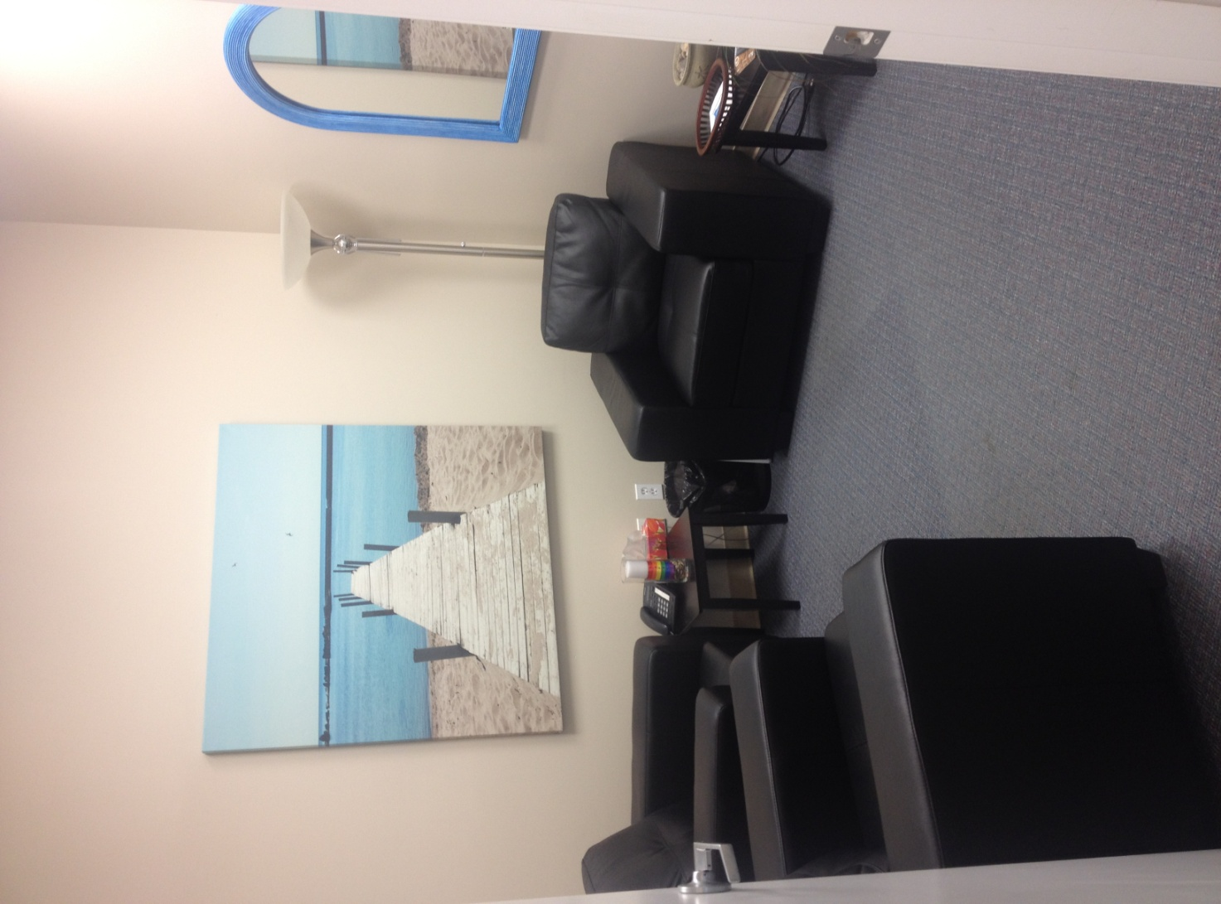
Notes:
“Paperwork is also a symbolic and practical reminder of one’s current homeless state and the lifestyle’s associated risks and deficits. Therefore, the longer you sit for an intake interview, for example, to fill out forms, the more it hits you: you are homeless and dependent on others at a time when you both want and need to become independent”…Dr. Yale Belanger. Assessing Youth Homelessness in Lethbridge, Alberta 2014

Slide 5
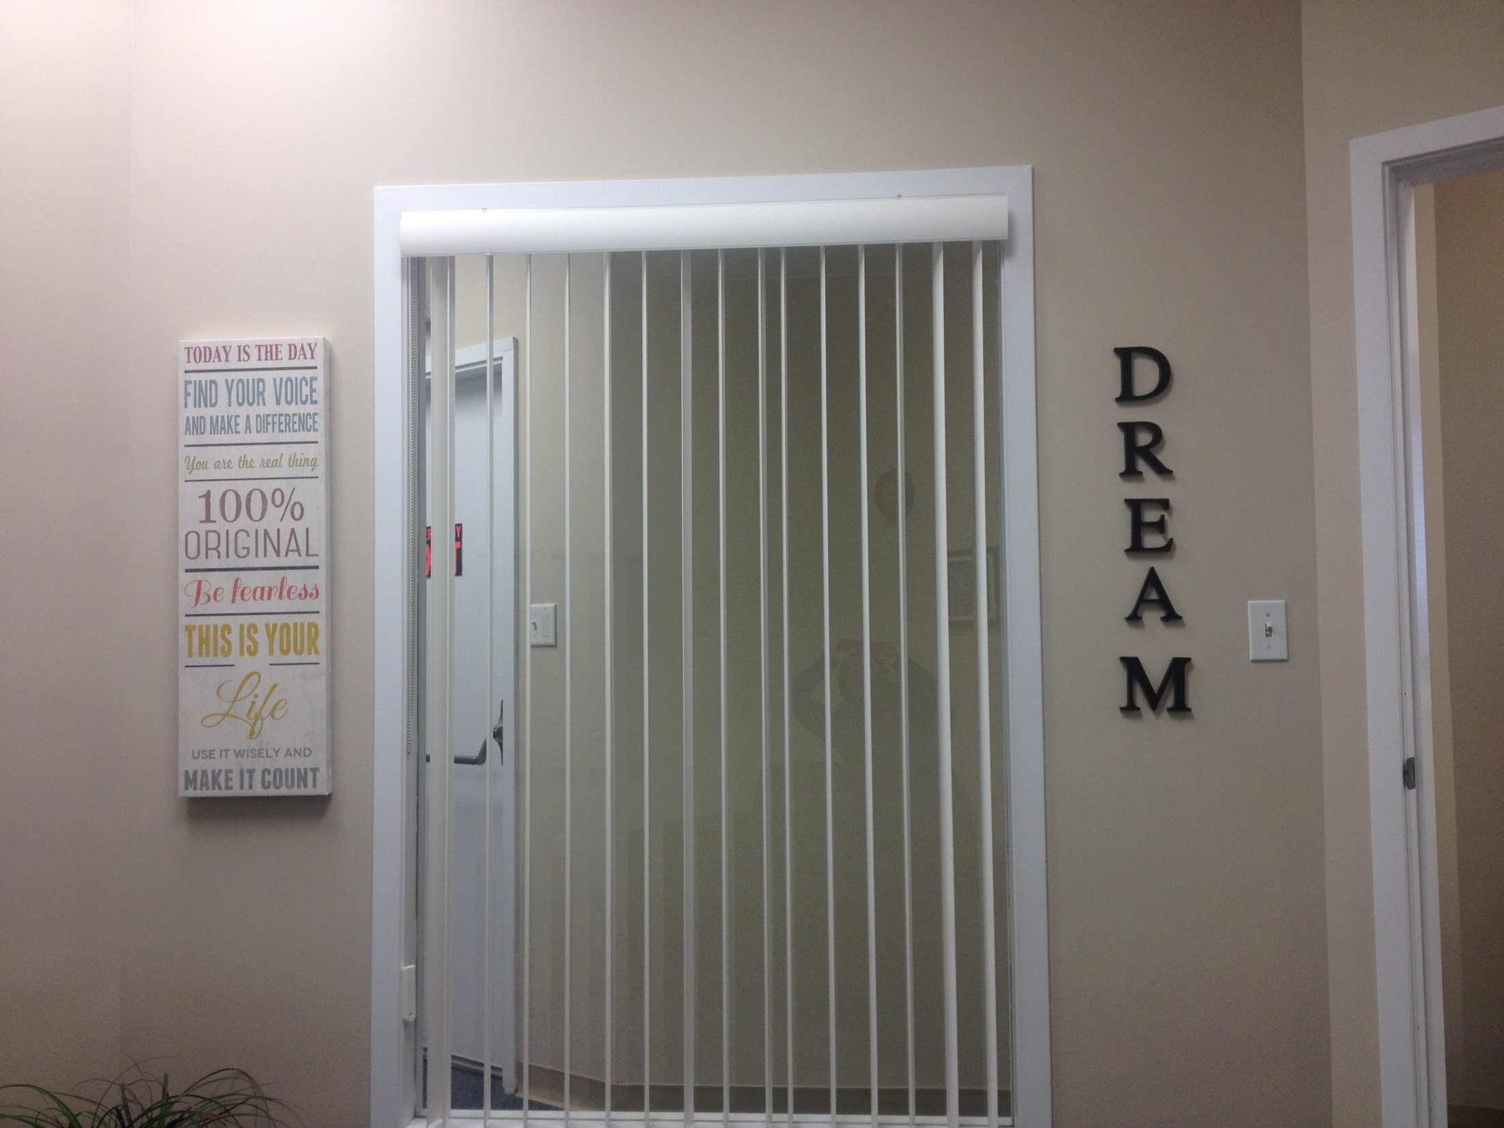

Slide 6
TRENDS
Youth we see are entering a state of homelessness consistent with those listed in the Youth Plan
Connection through social media
Youth are one of our major referral sources
Notes:
-Phsyical, sexual, emotional abuse
-Involvement in Child Intervention System
-Discrimination
-Homophobia
-Poverty

Slide 7
Moving Forward
Specific assessment tool for youth (including a specific section on mental health)
Attention given to preventing burnout in front line workers
Centralized intake can play an important role in taking a proactive approach

Slide 8
Transition to Independence Program (TIP)

Slide 9
Less than 1% of youth in Southern Alberta are in care 40% of homeless youth at one time had Children’s Services status WHY?
...Making a difference in our community!

Slide 11
Transitioning to Independence cannot occur without supporting youth in transitioning to adulthood

Slide 12
Program Criteria
Between 16-24 years of age
Have status with Southern Alberta Child and Family Services
Consent to participate in the program
Be referred through the Youth HUB

Slide 13
Program Model
Youth are unique with different causes of homelessness; therefore, the program supports youth through a variety of housing placement options with varying levels of support.

Slide 14
Program Model
McMan Rental Home with Youth Mentors
Roommate Companions
Supported Independent Living in the Community

Slide 15
Important Considerations
“Disability Lens” training for social workers
Debate between compliance based versus skills based
Clarity of roles

Slide 17
Thank You!
Nichole Fox
Program Supervisor
Youth HUB
Transition to Independence Program
403-915-5207
Nichole.fox@mcman.ca
……Making a difference in our
COMMUNITY

