Slide 1
Outreach and Housing Access
Adam Melnyk and Blake Thomas
< RIGHT CLICK PHOTO TO CHANGE PICTURE

Slide 2
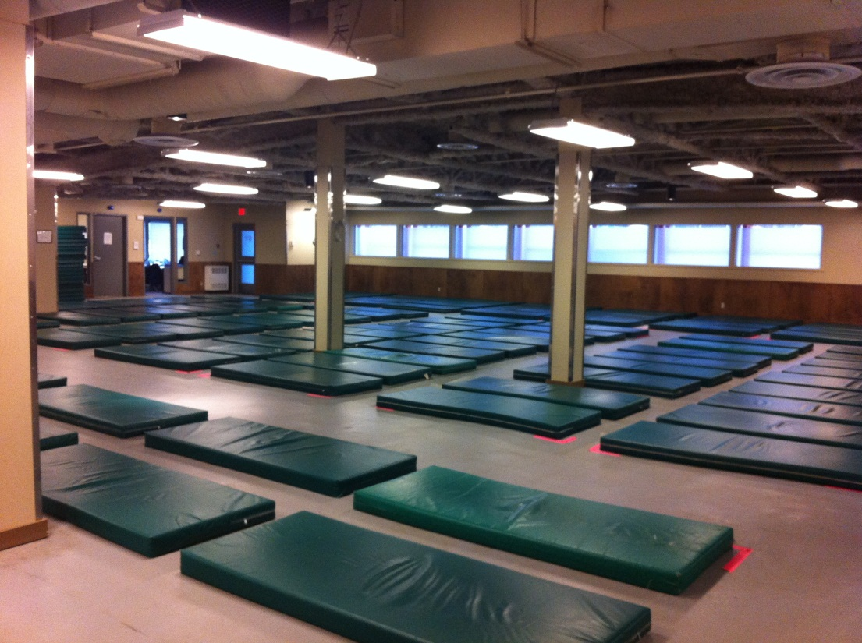
Alpha House Society
Established in 1982
120 matts – low barrier shelter
30 bed social detox
12 bed transitional
Programming
Outreach Nurse
50% Aboriginal

Slide 3
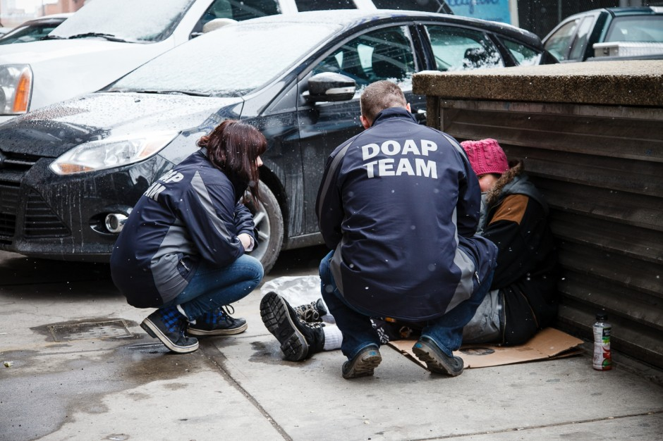
Downtown Outreach Addictions Partnership
DOAP Team - operates 24/7 and goes anywhere in the city
2014 – 17,853 transports for a total of 2600 unique individuals.
The DOAP Team is a alternate and more appropriate social response to substance use issues, which result in reduced pressure on Calgary Police Service, Emergency Medical Services, Calgary Transit and local hospitals.

Slide 4
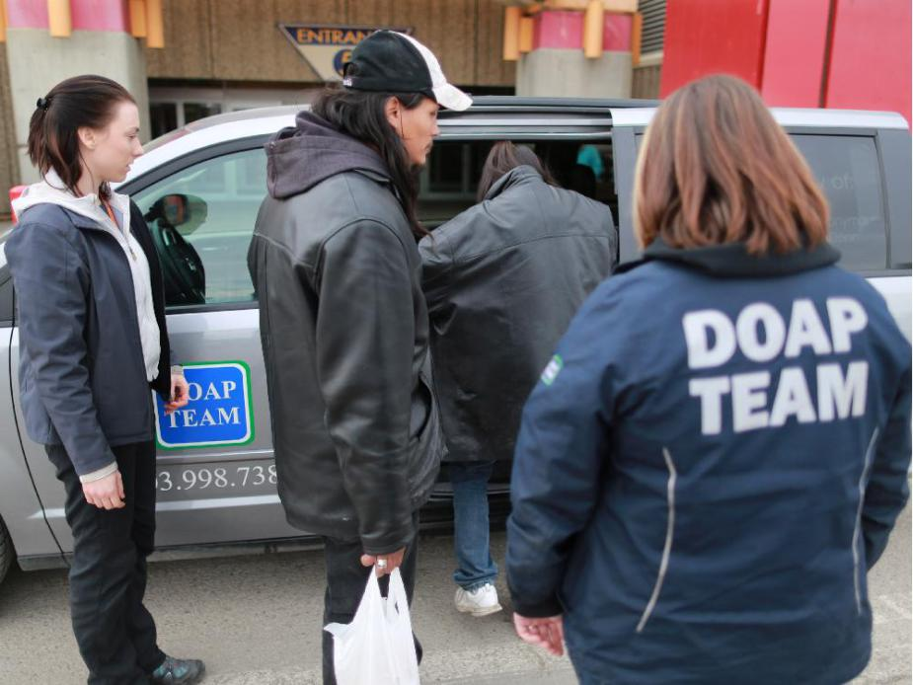
Outreach - DOAP Team
Social Return on Investment - $1:$9.43
Diversion work with security, businesses and concerned citizens
Work with hospitals in the Emergency Department and Units

Slide 5
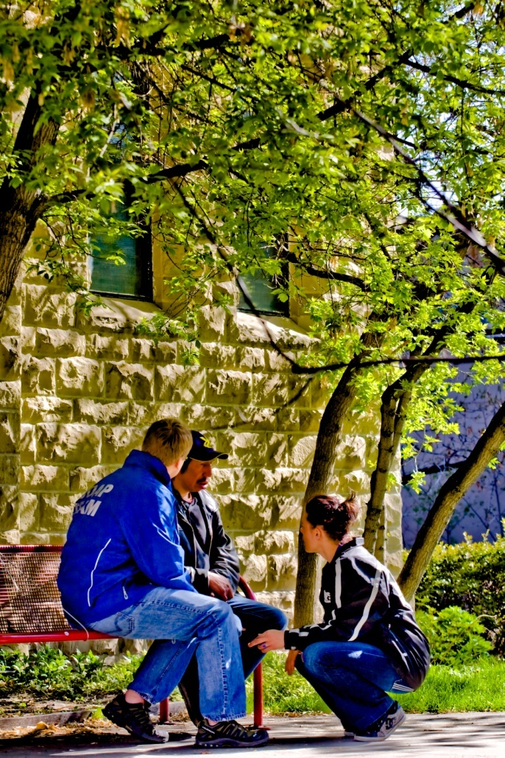
Outreach – DOAP Team
Knowledgeable staff
Non-judgemental service
Engagement and build rapport
Positive alternate response
Education work in the community

Slide 6
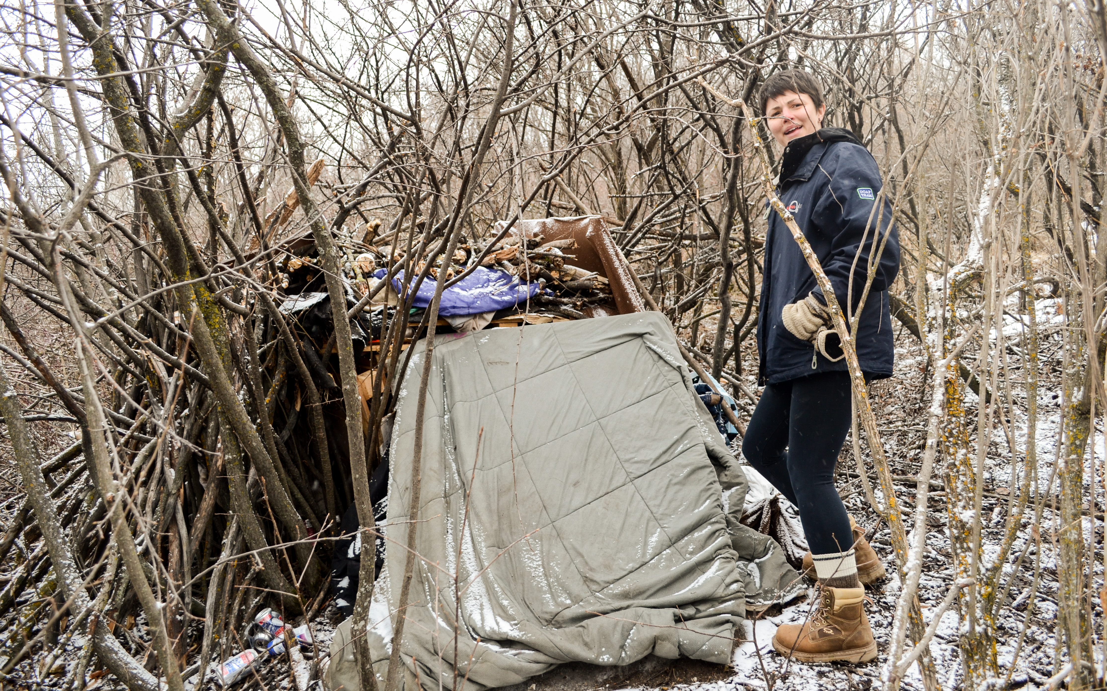
Outreach - Encampment Team
Housing intake
Pre-housing/paperwork: Medical appointments, income, bank accounts, furniture
Engagement and rapport building with roughsleepers
Assisting clients in other housing programs

Slide 7
Coordinated Access and Assessment
Many programs do not have direct access to clients
Motivated to see clients get connected
Need for front line programs that interact with a large amount of people
Support with clients housed or experiencing homelessness
Calgary Case Management Group

Slide 8
Strategies on Housing First
Creating and Maintaining Stability with Clients and Landlords
Jennifer Skabar & Steven Richardson
< RIGHT CLICK PHOTO TO CHANGE PICTURE

Slide 9
History of Scattered Site Program
Scattered site program has existed for 5 years
Provide a rent subsidy that ranges in value based on clients income
Scattered site program has 160 participants
On average we house 11 clients a month in the community
Clients in our program experience issues with drug and alcohol addiction, mental health issues and chronic homelessness

Slide 10
Concept of Best Fit
Meet the client and understand their lifestyle and needs
Access resources that have interacted with the client in the past
Knowledge of past housing experience is vital
The first available option is not always the best option
Staggered Placement

Slide 11
The “Pitch” and Viewing
Get off the phone and get face to face
One opportunity to educate and impress
Explaining the value of a middle man
Negotiate the terms of the lease
Prepare the client for the viewing

Slide 12
After the Lease is Signed
Follow up with the landlord within the first 2-3 weeks
The first 3 months – ownership and accountability
Call social assistance cheque line to ensure that rent is sent on time
Unit inspections to deal with damages before they become a bigger issue
In quire about new units

Slide 13
Landlord Relations – Responsiveness
Educate the landlord on rules and regulations of the Alberta Residential Tenancy Agreement
Ensure that warnings and evictions are done correctly and are supported
Rent will be paid, even if it is late
In the worst case scenario, being the point of contact to allow a landlord to vent
Little gestures make a difference

Slide 14
Questions?

