Slide 1
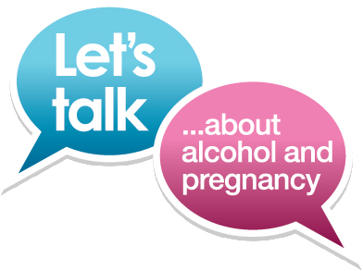
FASD • A Shared Responsibility
Notes:
Thank you for having me come out today to talk about the who, what, when where and how of the Fetal Alcohol Spectrum Disorder Prevention Conversation Project; A Shared Responsibility.
My name is Ashley Baxter and I have been contracted by the Edmonton Fetal Alcohol Network in the position of Prevention Conversation Facilitator.
This project is a 1- year coordinated response with the Province of Alberta and the Service Networks (there are 12 in the Province), to bring awareness and prevention efforts to our communities and hopefully all Albertans.
The aim of this project is to encourage you to support open and non-judgemental conversations with women and their support systems about alcohol and pregnancy.
Who we are targeting is medical and social service staffs/agencies to inform you about what is the messaging we would like you to use in your conversations within women, their partners and families in talking about alcohol use in pregnancy. Our second target group is women themselves of child bearing years, defined as 18 – 45 in the conversation itself (so for example at community events, Mom & Tot shows…)

Slide 2

Notes:
What we are hoping:
If I talk with you today, and each of you talk with someone next week, and each of them talk with someone else in a week…hopefully by the end of this project, all Albertans know about FASD (which I think we are there), but importantly understand what it means and what it takes to prevent this disorder and babies being prenatally exposed to alcohol.

Slide 3
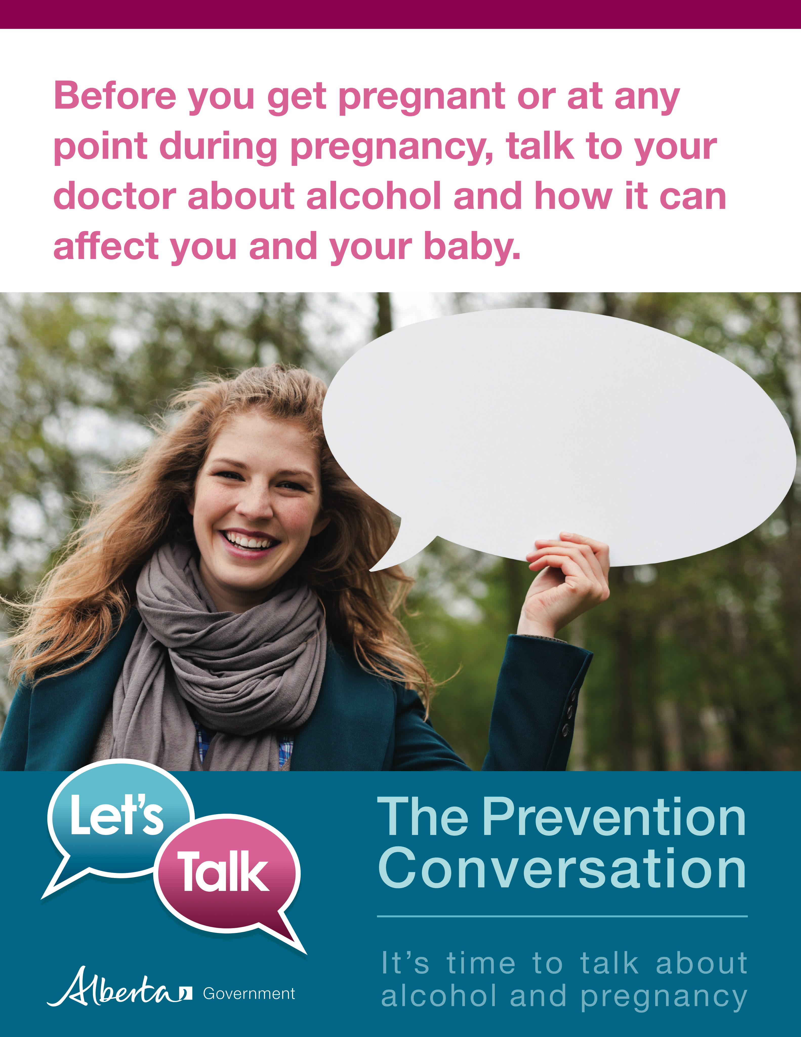

The Prevention Conversation Project
Notes:
The meat and potatoes: We would like you to take the messaging which we will go through and bring it into the work you do with clients (where appropriate) and into your personal lives.
We would like you to engage women, pregnant women, women planning a pregnancy, women of child bearing years in conversations that are:
Authentic
Sensitive
Woman centered
Trauma informed
Motivational (shaming and blaming do not work). When a co-worker was pregnant her health nurse asked (while not making eye contact) ‘You are not drinking alcohol are you?’. This is not what we want. A better approach ‘Are you aware that drinking alcohol while pregnant can cause harm to the baby?’...continue on with the conversation.. ‘There are resources and supports available to support women to make healthy choices for healthy babies’
We know that a brief intervention, simply asking the question ‘are you are that drinking during pregnancy can harm the baby?’, this brief intervention will reduce alcohol consumption or eliminate it by 30%
We also know that people need to see or hear messages at least 5 times before the message sticks, so we are asking for your help in getting these conversations started..

Slide 4
What do we do to try to make people change?
Give them Insight - if you can just make people see, then they will change
Give them Knowledge - if people just know enough, then they will change
Give them Skills - if you can just teach people how to change, then they will do it
Give them Hell - if you can just make people feel bad or afraid enough, they will change
Notes:
4
They don’t see (denial, lack of insight)
They don’t know
They don’t know how
They don’t care
4

Slide 5

What do we know about change?
Perceived benefits of change must be personally relevant for change to happen.
Why is this relevant to me?
Notes:
We still have a disparity between knowledge and behaviour.
People know about FASD but we are not necessarily seeing a change in behaviour. Planning pregnancies, not drinking while pregnant, the partner supporting alcohol free pregnancies.
We have to make the conversation relevant to everyone.
FASD is a community issue that requires a community response.
5

Slide 6
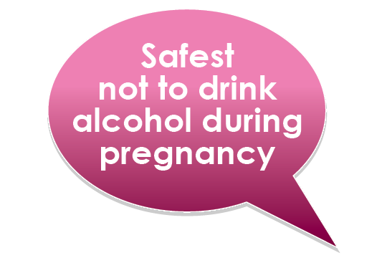

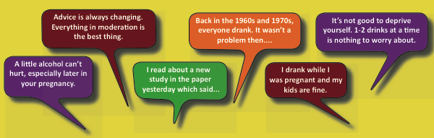
Notes:
No wonder why women and communities are confused about alcohol and pregnancy, there is a lot of misinformation out there and people don’t know what to believe.
- The Toronto Star recently published a research article and the heading was ‘Moderate alcohol drinking in pregnancy results in children with more positive behaviours’…the researcher even indicated that the results were due to the environments that the children grew up in.
Some of the facts:
Where there is alcohol there are FASDs.
No safe time to drink during pregnancy.
No safe limit.
All alcohol is harmful.
Safest approach is not to drink at all.
Binge drinking and heavy drinking are particularly harmful (induced peek blood alcohol concentration).
Women who have diets lacking in vitamins and nutrients, specially folic acid, may have exacerbated biological teratogenic effects of alcohol.

Slide 7

Who Drinks During
Pregnancy?
Light/Moderate/Heavy drinkers
Higher income, higher education, over 30, successful
Poor and isolated women
Multiple drug users and alcoholics
Victims of violence (childhood, domestic)
Notes:
50% of pregnancies are unplanned
63% (if not higher), consume alcohol before pregnancy
11% report drinking while pregnant
For woman of highest income bracket, 40.5% report drinking
There are many reason why females may drink in their pregnancies:
A woman may be unaware that she is pregnant:
Women may be unaware or underestimate the damage caused by alcohol on the fetus.
Alcohol may be the norm for their social group.
Women may use alcohol to cope with difficult life stressors, it is a socially sanctioned destressor (violence, depression, poverty or isolation)
Women may struggle with alcohol addictions.
4. Some women (all age groups and socio-economic backgrounds) are at risk if those around them family, friends, partners drink on a regular basis.
So who do we want to have the prevention conversation with…all women.

Slide 8



Prevention Efforts Must…
Move the focus from a woman’s alcohol use to understanding the related health and social problems that contribute to FASD.
Notes:
So we know now that we cannot focus our prevention efforts, our conversations, our posters and awareness campaigns solely on a woman’s alcohol use but we need to create an awareness to the factors that contribute to her continued alcohol use.

Slide 9
How to prevent FASD
1. Build public awareness and health promotion.
2. Discuss alcohol use and related risks with all women of childbearing years and their support networks.
3. Provide specialized, holistic support of pregnant women with alcohol and other health/social problems.
4. Support new mothers to maintain/initiate changes to support the development of their children.
To learn more about prevention services in Alberta, contact your local FASD Service Network.
Notes:
Alberta has many FASD prevention activities underway including programs and support services that aim to minimize damage to the fetus, reduce the chance of further affected pregnancies, and help the mother to effectively care for her children. Prevention activities that follow Nancy Poole’s four-levels of prevention include (clockwise from top).
Raising public awareness such as with this presentation, as well as public policy and health promotion activities. For example, Alberta’s FASD Learning Series was introduced in 2007 to increase community and individual capacity to support individuals with FASD and their caregivers across the lifespan. The webcast and videoconference educational sessions cover a broad range of topics that target both urban and rural audiences. More than 60 sessions have been recorded and are available online for viewing at fasd.alberta.ca.
Prevention also occurs when girls and women of childbearing years have the opportunity for safe discussion of pregnancy, alcohol use, and related issues, with their support networks and healthcare providers.
A third level of prevention includes provision of recovery and support services that are specialized, culturally specific and accessible for women with alcohol problems and related mental health concerns. Such services may include outreach, referral, screening or intervention.
And the fourth level of FASD prevention is about supporting new mothers to maintain healthy changes they have been able to make during pregnancy. Such services may include mentoring, substance abuse treatment, birth control, or parenting programs. For example the Parent-Child Assistance Program (PCAP) has the primary goal to prevent future births of alcohol and drug exposed children. This is done by addressing the needs of the mothers – and helping them to stabilize in a variety of ways. There are 24 PCAP sites throughout Alberta.
For all of these prevention activities to be successful groups involved with prevention must collaborate (i.e. social workers, medical professionals, policy makers, etc.). It is important to be flexible – everyone is an individual, so a “one-size-fits-all” approach does not work.

Slide 10
The Prevention Conversation:
Core Messages
  For the woman and her partner and family:
  Drinking can be harmful at any point during pregnancy and can result in lifelong disabilities. The baby’s brain and nervous system develop (and are vulnerable to damage from alcohol) throughout pregnancy.
  Alcohol and pregnancy don’t mix. If you drink alcohol and are sexually active, make sure you use effective contraception.
  If you’re pregnant or thinking about getting pregnant, consider talking to your healthcare provider or asking for help to learn more about support and services in your community.
Notes:
The messaging is not written in stone, but the reasoning and beliefs behind them are and is where we want consistency.
There is no known threshold of safe drinking, alcohol can have serious and permanent consequences.
Usually focus on not drinking while pregnant, now we want to focus on if you drink avoid getting pregnant. This means we have to have conversations about birth control and about those times for example if you are hung over and forget the pill or throw it up, what then?
Talk to care providers to providing quitting drinking before pregnant and starting prenatal vitamins even before conception. We know that women who lack certain vitamins like folic acid have enhanced teratogenic effects,

Slide 11

Core messages
  For the woman, her partner/family and her community:
  Friends, partners and family members can support a pregnant woman by asking how they can help her make healthy choices and healthy babies.
  For the service provider:
  Some women need support, care and treatment to help them stop drinking during pregnancy. Research points to the effectiveness of intervention. Engage them in The Prevention Conversation.
Notes:
Not about telling a woman what to do but rather asking her, how can I support you to make healthy choices for healthy babies. Many of our awareness campaigns have not involved the partner, friends and families. We want everyone to support healthy pregnancies by taking a pause from alcohol perhaps, not offering alcoholic beverages, make sure you have mocktails, take part in recreational and social activities that don’t involve booze and HELP REDUCE STRESS IN HER LIFE
When we look at biological mothers who have had children with an FASD most have been sexually, physically and emotionally abused, the majority have a meantal health disorder and most felt unable to reduce alcohol because they were in abusive relationships
We need to change the conversation. No women drinks because she wants to cause her baby harm. Change the thinking from: she doesn’t care about her baby, whats wrong with her, her drinking is a problem to what is going on in her life tht she is drinking, she is attempting to cope, what happened to her.
Asked: what would you do if you saw a pregnant woman drinking in the bar. My response ‘I would walk up and say let me finish that for you’ but I really wouldn’t. Rather I would go up and ask ‘I see you are pregnant, is this a happy time for you?’ When we assume all women would be happy pregnant, we stop the conversation.

Slide 12

How can we make a difference?
Promote the Prevention Conversation within your work and workplace!
Promote the Prevention Conversation within your personal life!
Advocate for planned pregnancies and healthy lifestyle choices.
Keep learning about the complexities of FASD and how it affects people.
Remember: FASD affects all of us!
Notes:
Stumbling block, what if you ask the question and a woman responds ‘yes I am consuming alcohol’, you can’t just end the conversation, I would ask something like ‘What is a successful pregnancy to you?’ ‘can I give you resources to help you achieve your success in this pregnancy?’
Personal Life response has been that people would not engage others in the prevention conversation because it is a private affair. We want to de-stigmatize the conversations about alcohol use and pregnancy. It is not about blaming but about providing the right information and resources.

