Slide 1

Inclusive Housing
A Community Based Approach to Housing First
Amanda St. Laurent

Slide 2

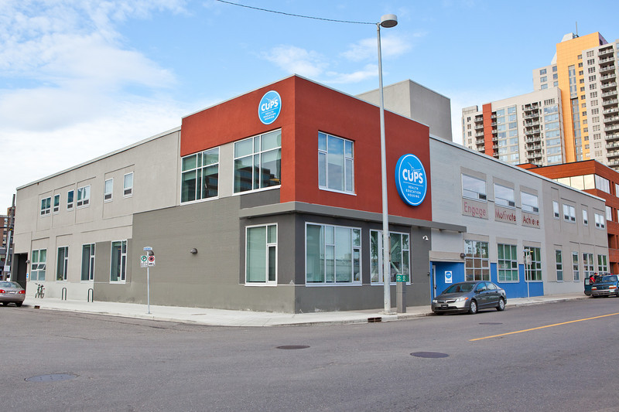
Overview
About CUPS
Program Objectives and Model
The Role of the Community Developer
Volunteers & Community Partnerships
Program Participants
Outcomes
Learnings

Slide 3



About CUPS
Clinics:
Primary Care
Women’s Health
Dental
Key Case Management
Community Development
ID Assistance
Client In Transition (CIT)
  Development Centres:
  Family
  One World Child
  Pre-natal to Three

Slide 4

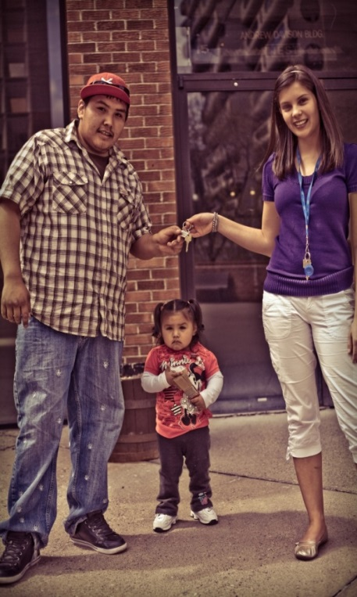
Program Objectives
Can individuals and families be successfully housed in a single site setting without intensive case management support?
Addresses two key components of homelessness – affordable housing and social isolation
Healthy people are a result of healthy and inclusive communities
Decrease dependency on the system

Slide 5

The Model
Partnership with the Calgary Homeless Foundation
Rent geared to income
Program participants are homeless or
have a history of homelessness
On site Resource Center
A Community Developer per building
Volunteers and the Community at Large
Program Participants

Slide 6
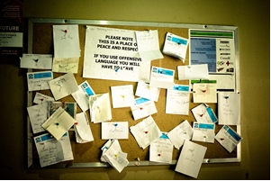
Resource Center
Tenant
Community Members
Common Space

Slide 7

The Community Developer
Assists with Community Navigation
Facilitates programming
Motivates and encourages
Pride and ownership of Community
Engage. Motivate. Achieve.

Slide 8
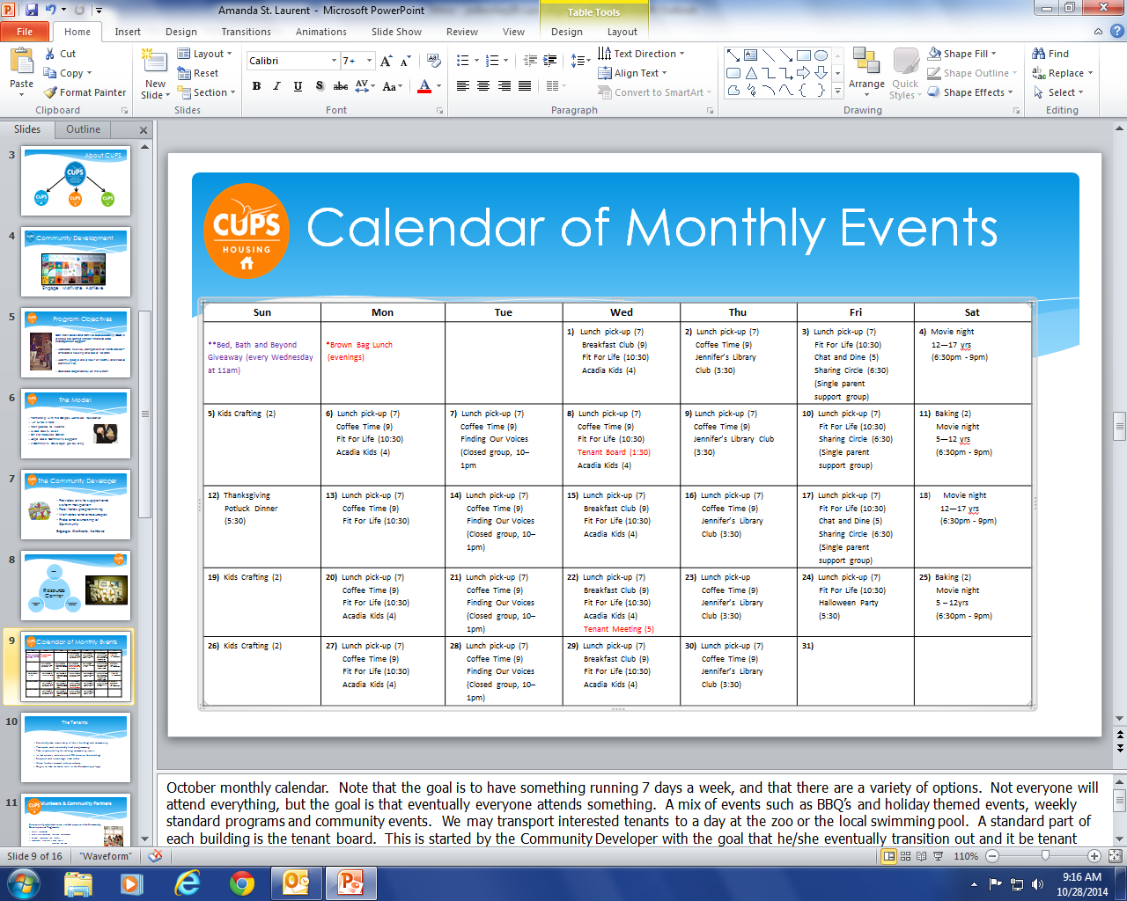
Calendar of Monthly Events
Wed
1) Lunch pick-up (7) Breakfast Club (9) Fit For Life (10:30) Acadia Kids (4)

Slide 9
Volunteers & Community Partners
Volunteers
Programs
Tenants
Natural relationships, KAIROS, Addresses NIMBYism

Slide 10
Volunteer Opportunity
Leadership
Independence
Tenants
Responsibility
Action
Problem Solving
Social support
Ownership

Slide 11

Outcomes
72% of participants housed 1+ year
Only 5% move outs were for negative reasons
87% of tenants attend 1+ program regularly
2455 tenant volunteer hours in 2014/15 annual report
887 external volunteer hours in 2014/15 annual report
36% of programs are tenant led
30% rental arrears
51% use of services (police, EMS and emergency)
Annual cost = $6421 / program participant (including rent subsidy, programming dollars and staff salaries)

Slide 12
911 calls
Marked decrease in 911 calls over last year
Tenants are more likely to deal with it in a more appropriate manner

Slide 13
Prevention
Income testing and subsidy where necessary
Included in all programming – relationships within the building
Community involvement
Housing is permanent with limited supports
Varied acuity levels
75% of tenants remain housed
5% move outs for negative reasons (eviction and non renewal of lease)
Programming offered to external community – targeted interventions

Slide 14
Learnings
When it doesn’t work – rehousing options
Keeping tenants engaged
Tenant fear of reprisal – landlord and peers
Expectation: agency will resolve problems
Participants can self manage
Social isolation and lack of support is likely a prime factor in return to homelessness
Notes:
.

Slide 15

Community Development
Engage. Motivate. Achieve.

Slide 16

Contact:
Amanda St. Laurent, Manager
Community Development & Engagement
(403) 206-1092
amandas@cupscalgary.com

